Slide 1
Non Neural Net ML, Neural Nets Review, GPU Acceleration

Slide 2
Housekeeping
Last class was too heavy of a data dump, so I’m changing to a story format
Please tell me what you think
Anyone with persistent issues registering for the class needs to see us TODAY
Please tell me if there’s issues with the video
Quiz postponed
Previous lectures up
You should rewatch them based on what you’ve told me
Doing Game AI instead of Gensim 2, see syllabus for some minor date sorting
The plan was to do Bayes and Markov stuff this week, it’s being postponed till next week and we’re doing GPU acceleration instead
Ask more questions
Cookbooky isn’t a word, I just don’t know a better way to describe it
Quiz next week on neural net theory

Slide 3
Overview
Review CNNs
Review Autoencoders
GPU acceleration
Non ML techniques
Deepfakes
Miscellaneous topics

Slide 4
Why my Saturday sucked, Part 1
CNNs, Autoencoders, Deepfakes, GPU acceleration

Slide 5
Deepfakes
Who here’s seen it?
Neural net based library for transferring faces from one image to another
This is trivially extendable to videos for those who know how to do video encoding
That’s also how ML is generally done for classification of information from videos that isn’t time-series dependent

Slide 6
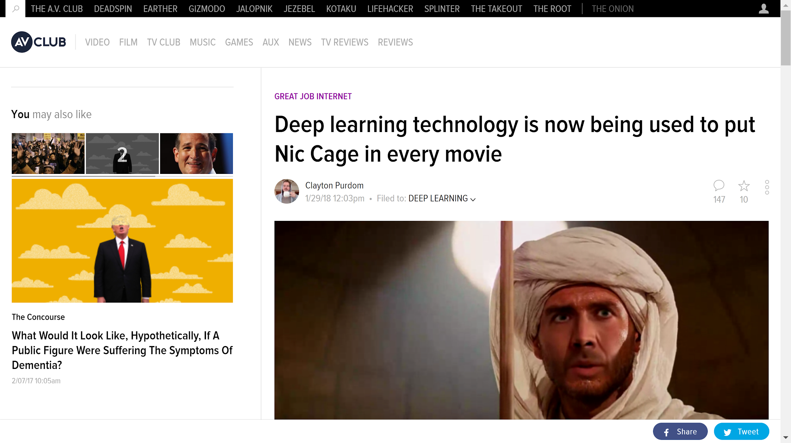

Slide 7
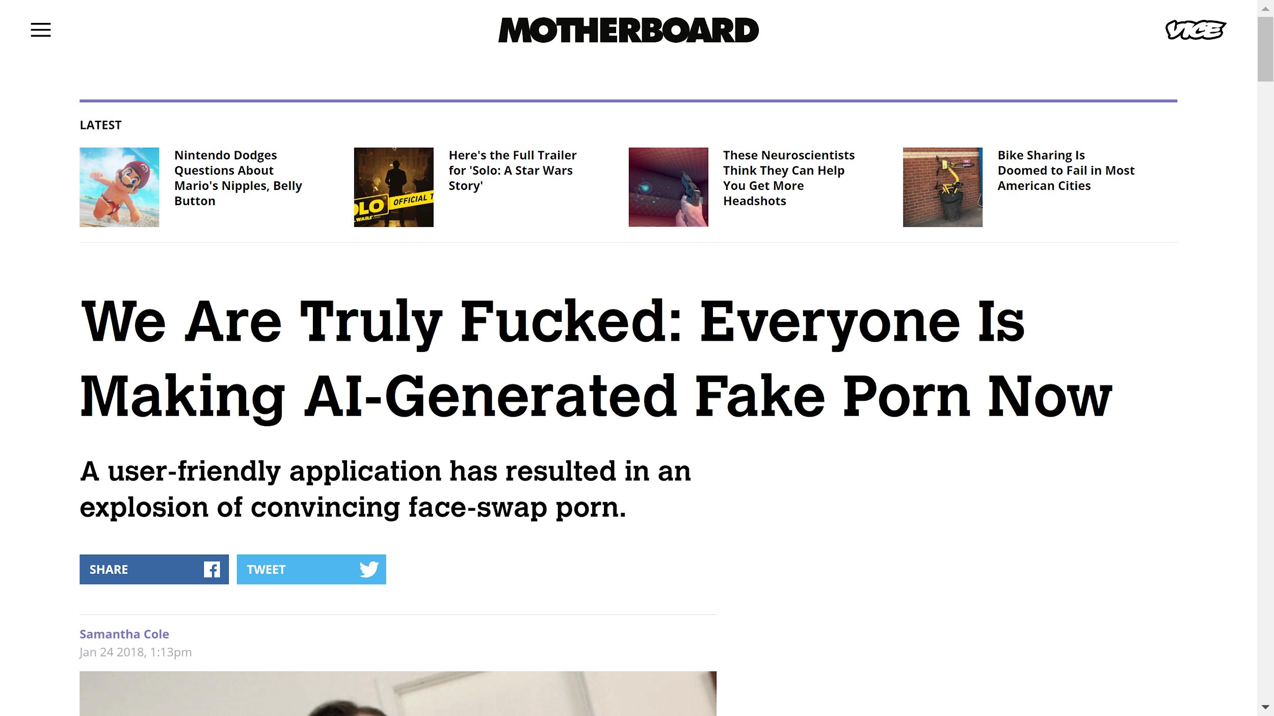

Slide 8
The results are really good

Slide 9
Deepfakes
I woke up saturday morning, and saw a Siraj Raval video on it
I’ve started actively trying to avoid the parts of the internet where I would’ve seen it earlier
So I had to try it
Python library on Github
Built using tools we’ll extensively cover in class (TensorFlow etc.)
Also all I wanted to do was put Hitler's face on Trump in his state of the union speech
Fakeapp is just this same code with a simple windows UI for it
How it works:
Hybridization of CNN and autoencoder

Slide 10
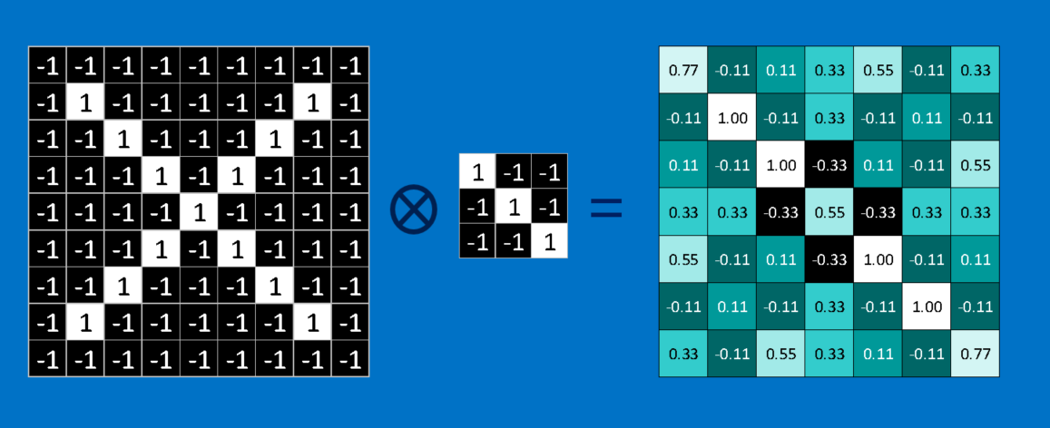
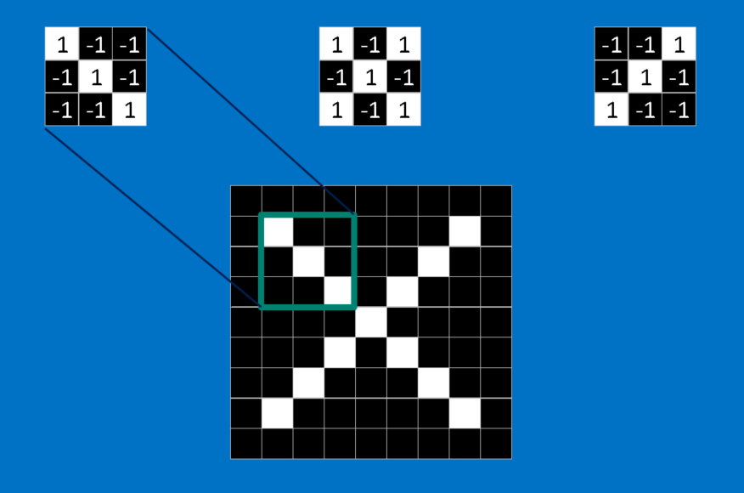
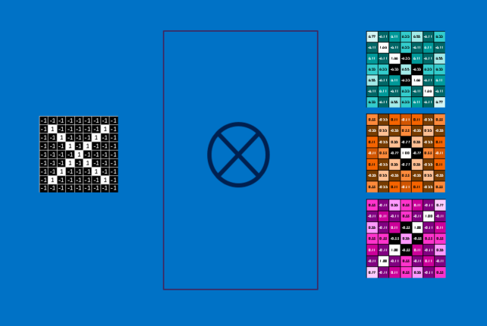
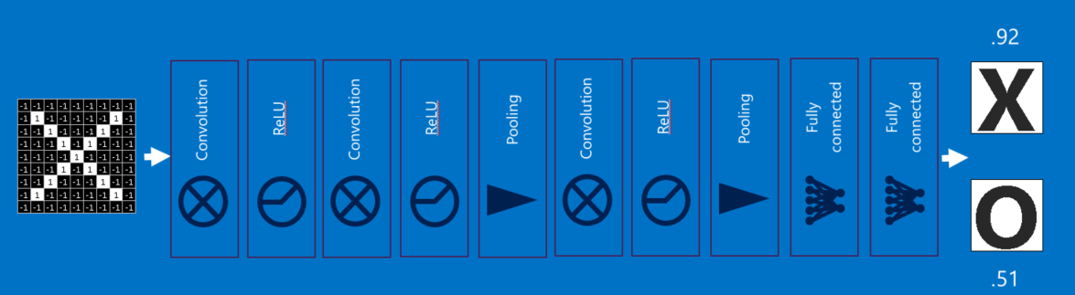
A review of CNNS

Slide 11
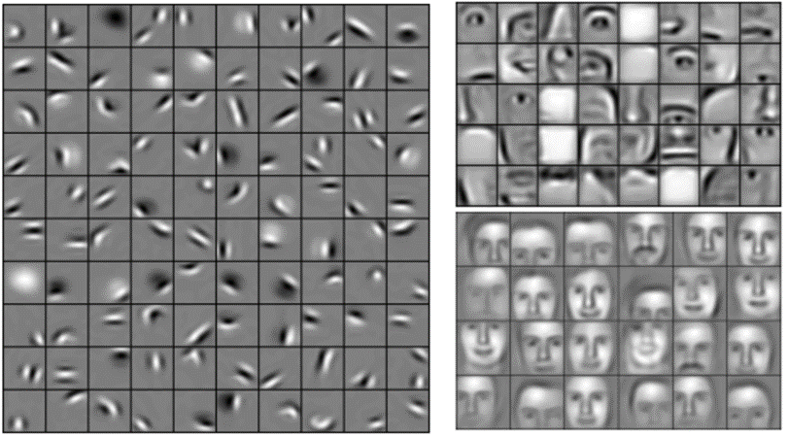
A review of CNNs

Slide 12
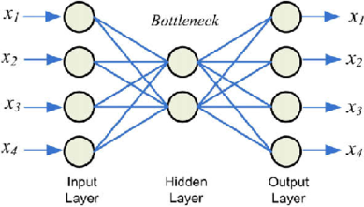
Autoencoders

Slide 13
Overview of deepfake generation process
Take sample images of person your transferring from, and person your transfering to
These images should have each person’s face, preferably with no other faces, against a high contrast background, from many angles, under many conditions, etc
Extract the faces from the images and align them
Without alignment, the CNNs filters would be less effective
Done via Histogram of Oriented Gradients (HOG) (see Siraj Raval)
Unsupervised technique
If you make an image black and white and then extract a vector map of the gradient, closed loops of large vectors pointing out of a region usually only happen for faces (rare otherwise)
Extra checks added

Slide 14
Supervised and unsupervised techniques
Supervised:
Create f in f(U)=V, given U and V
Neural nets
Superstatistics
“Labeled data”
Generally broken into classification or regression
Unsupervised
Find things about the data without being told anything about it
HOG, Rake, 100s others
Now days they tend to occur as fancy domain-specific algorithms
These are intrinsically limited and imperfect
General AI and game AIs are also unsupervised, and more general intelligence must be

Slide 15
Overview of deepfake generation process
Take sample images of person your transferring from, and person your transfering to
These images must have both persons face, preferably with no others, against a high contrast background, from many angles, in many conditions
Extract the faces from the images and align them
Without alignment, the CNNs filters would be less effective
Done via Histogram of Oriented Gradients (see Siraj Raval)
Unsupervised technique
If you make an image black and white and then extract a vector map of the gradient, closed loops of large vectors pointing out of a region usually only happen for faces (rare otherwise)
Extra checks added
Check extracted images by hand
Train neural network

Slide 16
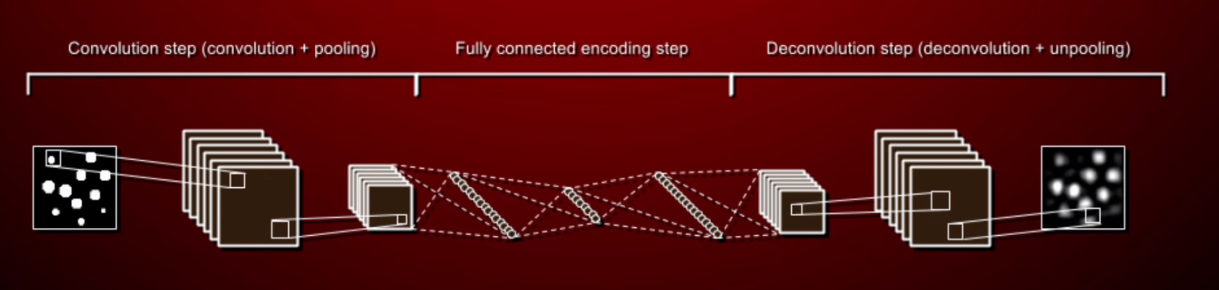
Each face uses the same encoder step and a separate decoder step

Slide 17
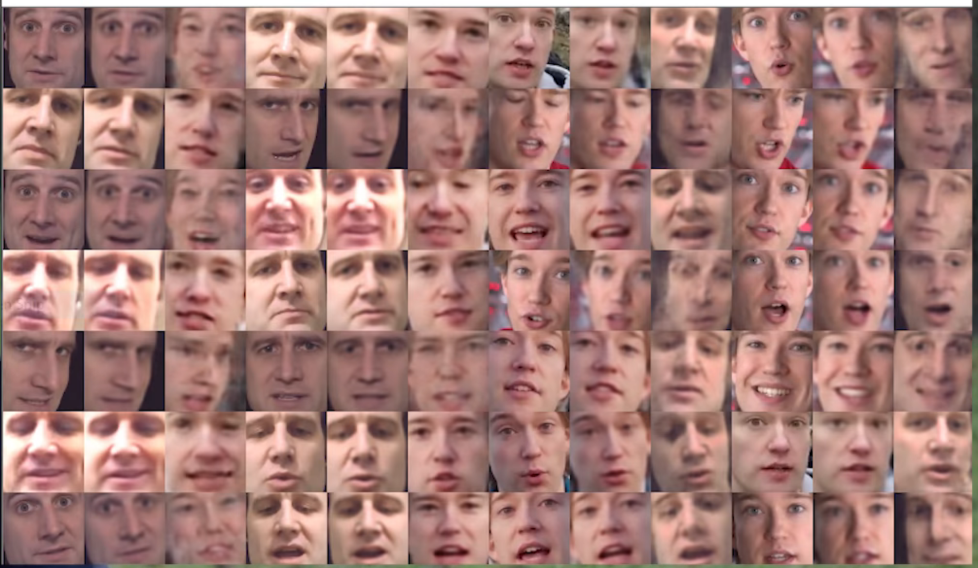

Slide 18
Overview of deepfake generation process
Take sample images of person your transferring from, and person your transfering to
These images must have both persons face, preferably with no others, against a high contrast background, from many angles, in many conditions
Extract the faces from the images and align them
Without alignment, the CNNs filters would be less effective
Done via Histogram of Oriented Gradients (see Siraj Raval)
Unsupervised technique
If you make an image black and white and then extract a vector map of the gradient, closed loops of large vectors pointing out of a region usually only happen for faces (rare otherwise)
Extra checks added
Check extracted images by hand
Train neural network
Use neural network to detect target face, and put other face on it with the same expression etc
Do for each frame in the case of video

Slide 19
Training Issues
Slow
Tons of linear algebra
Requires GPU acceleration

Slide 20
GPU acceleration
Who knows what an architecture/assembly language/instruction set is?
ASIC (Application Specific Integrated Circuit)?
GPUs vs CPUs; Moore’s law
Graphics in games are all linear algebra- matrices transforming vectors
Compiling to them is weird, so they are based around APIs (Application Programming Interface)
OpenGL, DirectX
People wanted to do more things with GPU hardware that the APIs couldn’t
Photo editing, 2D video editing, audio editing, cryptography breaking
“GPGPU”
So they made new APIs
OpenCL and CUDA
Except by this time GPUs were in such high use that they could do everything a CPU could
Just must slower
So the new APIs were more akin to programming languages (based on C) with special, really weird compilers/interpreters
This is why the major cryptocurrency miners are creatively named CUDA Miner or OpenCL miner

Slide 21
OpenCL vs CUDA
OpenCL
Open Compute Library
Runs on all GPUs (AMD, Intel, Nvidia, Apple)
Open source
Easy to get configured
CUDA
Compute Unified Device Architecture
Only runs on Nvidia cards
Closed source
cuDNN
Horrible to get configured

Slide 22
Why Nvidia has a monopoly on GPUs for ML
Massively better performance from one card for ML tasks
1+1!=2
True for creative programs as well
Power efficiency doesn’t matter
This is a way more valuable use of GPUs than cryptocurrency mining
Specialized architectures
Nvidia’s GPU lines
Geforce
Quadro
Tesla
Titan (?)
Neural net type tasks are ~40% faster with CUDA than OpenCL on Nvidia cards (although not true for almost any other types of tasks)
Most ML libraries, very notably including TensorFlow, run only with CUDA support
This is also true for creative programs, and for those with support from both, CUDA support is often better or more things can be accelerated with it
Overview of TensorFlow
Volta, hardware concerns

Slide 23
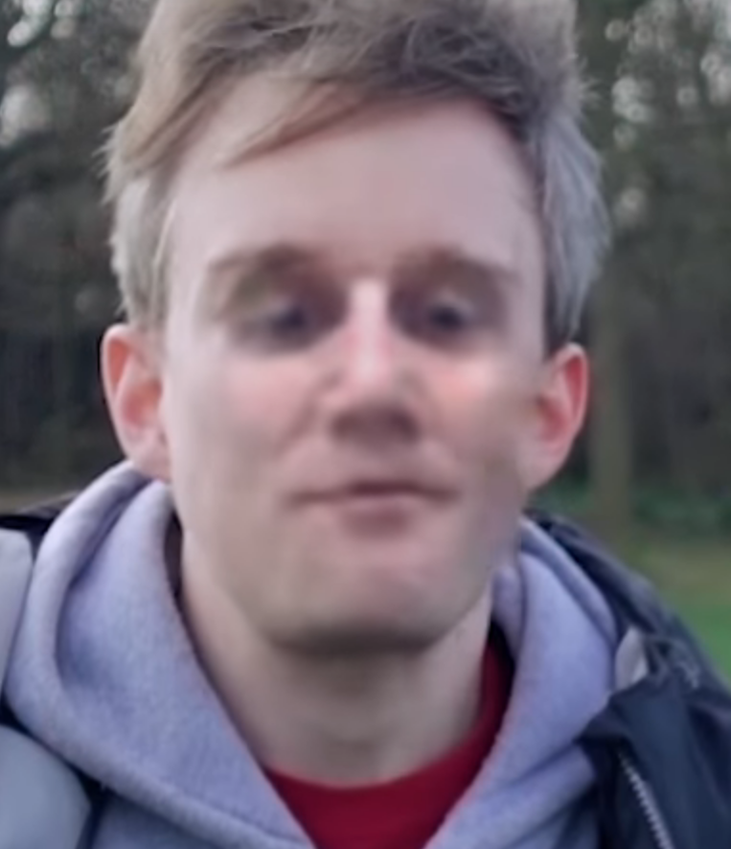
Training Issues
Slow
Tons of linear algebra
Requires GPU acceleration
Transfer learning
Also helps to add generality
Large amounts of good data is key
Blurring things near faces
Looking the other way
Expressions
Generally good photos
Diversity helps, except when it doesn’t
Nothing in front of face
Vanishing gradients
Entire model is ~300MB total when highly compressed

Slide 24
Part 2 on GPU acceleration configuration in Linux will be next week

Slide 25
That time I tried to hack Google’s job application process, Part 1

Slide 26
Legal disclaimer: I never actually attempted this, I got a different job before I could. I do not recommend or condone the following method.
Also this doesn’t count as hacking under US law

Slide 27
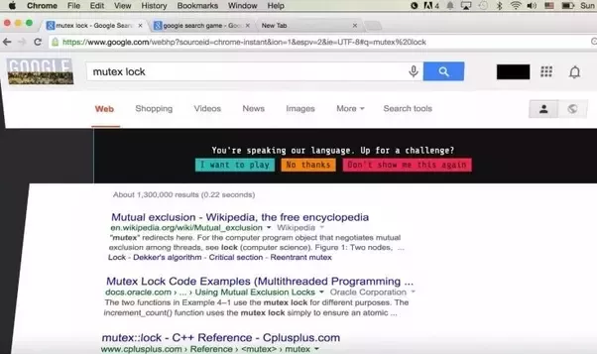
Google FooBar

Slide 28
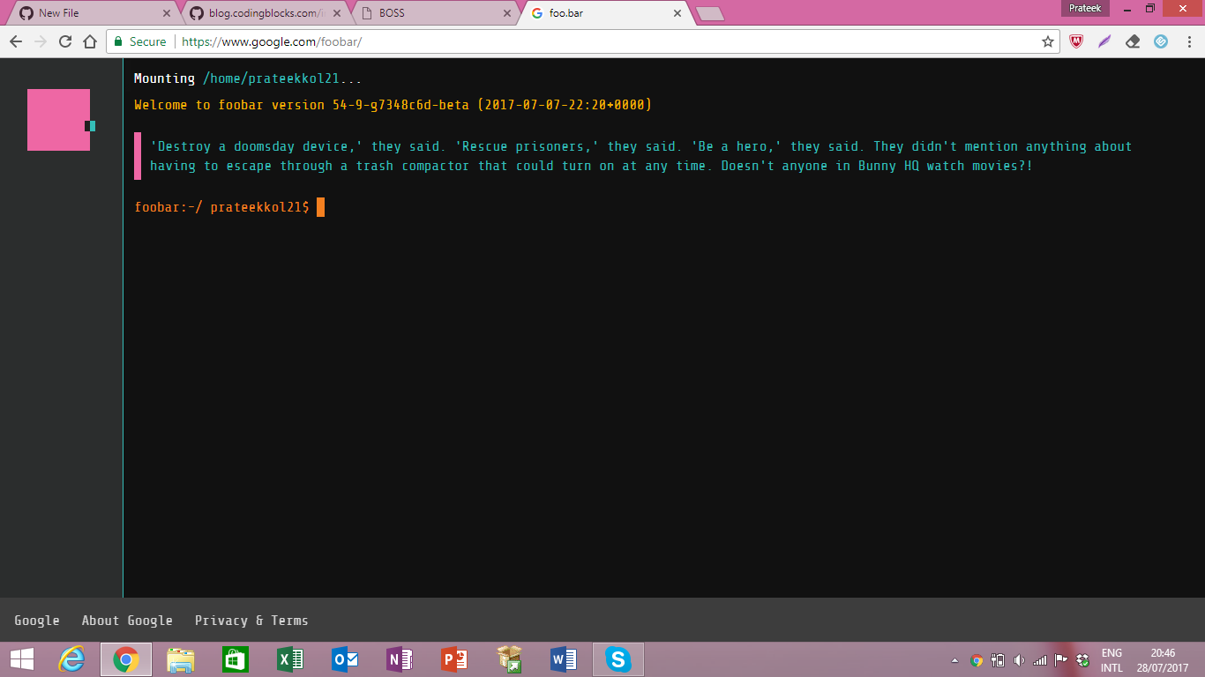

Slide 29
The hunt begins
The goal is to submit text to Google search that returns a direct link to this programming challenge
If you try to try to wget a Google search page or query it in urllib, it returns an encrypted cookie
So you’d have to just about make a web browser to use it
There’s a command line way to do that in Linux that I won’t cover here
Let's think through how to do this
Not everyone searching a particular phrase or topic gets connected to the challenge
So it’s not keyword based
Implies it’s most likely at least partially based on the user’s past search queries
My goal: submit quality clumps of words repeatedly until $$$
A neural net is cludgy and hard, doesn’t seem appropriate
Words are complex, and you need a super big neural net to handle all of them
Using more detailed user data is probably too creepy, even for them
It would also be difficult to build the challenge system using that kind of data… seems unlikely for this kind of little side-project
So I figured they used a SVM or clustering technique, which are based on word vector representation

Slide 30
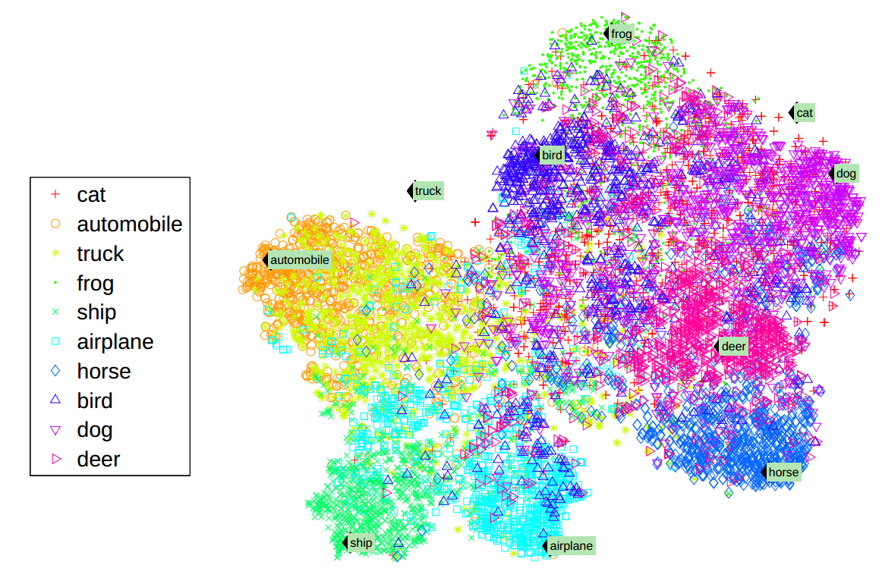

Slide 31
SVMs
“Support Vector Machine” is a probabilistic binary linear classifier (vectors)
Drawing a line in high dimensional spaces
Closest ML technique to Least Squares Regression
Done using SK Learn or TensorFlow libraries (we’ll talk about these in detail later)
Can be done using Hard or Soft training
Lots of pure CS theory behind it...
More understandable and less computationally intensive than neural nets
Still intensive
Less powerful
Nonetheless adequate for this kind of task
Generally smoother decision boundary, can be harder to overtrain or represent highly nuanced functions than with neural nets
Good at anomaly detection

Slide 32
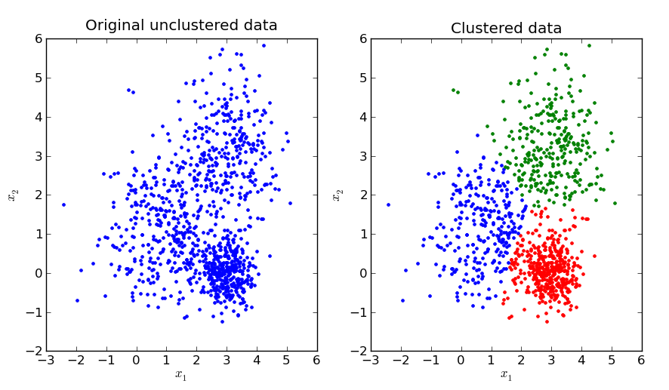
Clustering
Clustering is an unsupervised technique that, when given data, will put it into “k” similar clusters
Lots of ways to do this, cookbooky
Support Vector Clustering
“K-means” clustering
“k-means clustering aims to partition n observations into k clusters in which each observation belongs to the cluster with the nearest mean, serving as a prototype of the cluster.”
Density based
Distribution based
Again done with SKlearn, TensorFlow
Easy to understand, not very computationally intensive
Less power for anomaly detection

Slide 33
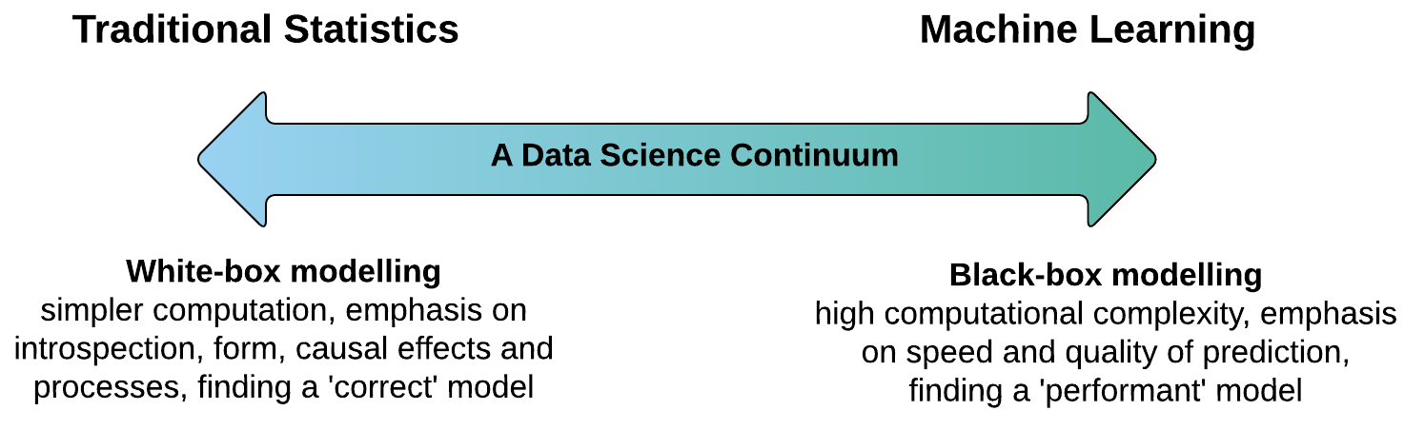
ML vs Statistics

Slide 34
Part 2 on the language specifics will be covered later in the semester

Slide 35
Some things that don’t fit elsewhere

Slide 36
Monte Carlo simulation

Slide 37
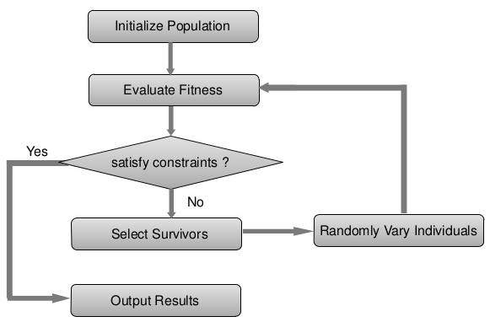
Genetic Algorithms
Original AI technique
Broad class, no one main implementation library (hence algorithms)
I think Genetic algorithms will play an increasingly important role in the future
Semi-Universal Characteristics:
Fitness function
Genetic Representation
Applications to neural nets and morphologies
Evoling robots to walk (2:40)

Slide 38
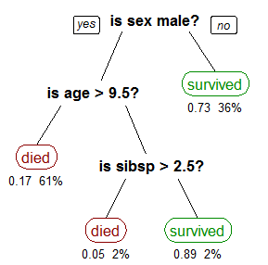
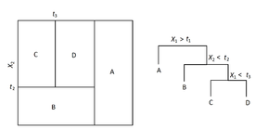
Decision Trees
Good for things where there are few variables that have independent impacts on the outcome
Good for when you really need to understand the model
Not computationally intensive
Tend to produce poor results for function replication
Can be done with tools in SK Learn library
Created via recursive partitioning
This obviously tends to overfit

Slide 39
Random Forest
Group of decision trees made off random subset of data, most frequently made prediction is accepted
Generally better results than single decision tree
Especially harder to over fit
More computationally intensive
Doesn’t work well with some sorts of data
Cookbooky ways to slightly beat random sampling with replacement

Slide 40
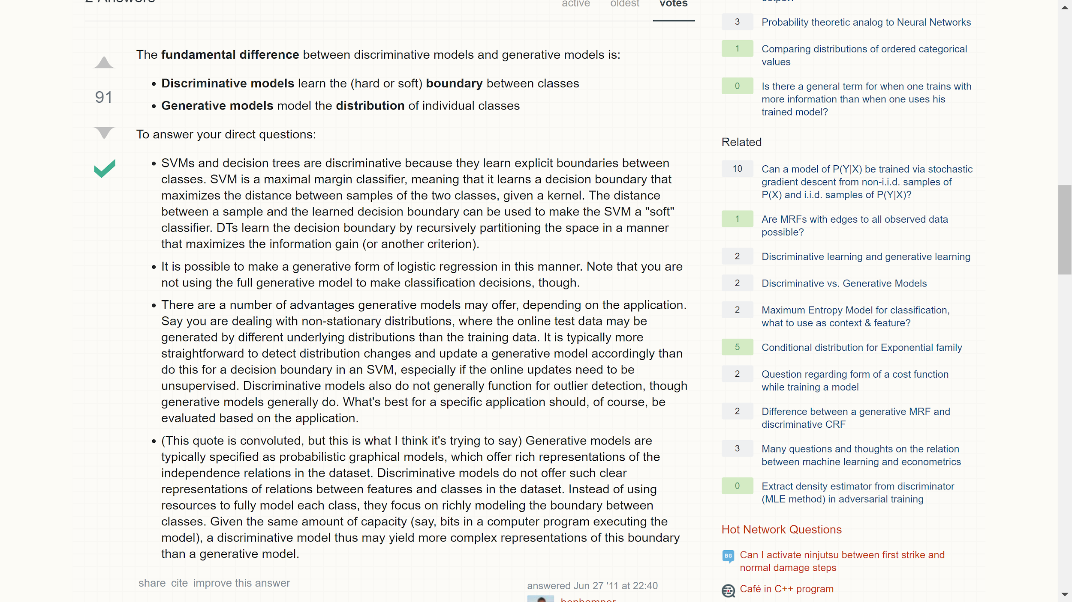

Slide 41
When to use which ML technique?
Use the right ML technique for your problem
There’s a reason 5/6ths of the time spent on ML techniques has been on neural nets
Fastest, simplest, easier to understand is best
Specialty techniques can give better results due to making over training etc harder
Example of tasks for which each technique is usually preferred:
Decision trees- medical diagnosis
Neural nets- vision, function replication
Genetic algorithms- teaching a 3D creature to use its muscles
Clustering- what country are all these IP addresses from?
SVM- anomaly detection

Slide 42
Noticed after class
http://setosa.io/ev/markov-chains/ is awesome

